Slide 1
MODULE 5
SECURITY IN THE CLOUD

Slide 2
Security Overview
Cloud Security Challenges
Security -as-a-Service
Security Governance
Risk Management
Security Monitoring
Security Architecture Design
Data Security
Application Security
Virtual Machine Security.

Slide 3
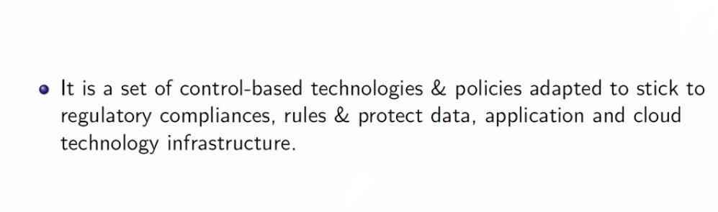
Deﬁning cloud security

Slide 4
Security Overview
Cloud service providers are leveraging virtualization technologies combined with self-service capabilities for computing resources via the Internet.
In these service provider environments, virtual machines from multiple organizations have to be co-located on the same physical server in order to maximize the eﬃciencies of virtualization.

Slide 5
Cloud service providers must learn from the managed service provider (MSP) model and ensure that their customers’ applications and data are secure if they hope to retain their customer base and competitiveness.
Today, enterprises are looking toward cloud computing horizons to expand their on-premises infrastructure
But most cannot afford the risk of compromising the security of their applications and data.

Slide 6
Security in cloud concerns how resources should be protected in the Software-as-a-Service (SaaS), Platform-as-a-Service (PaaS), and
Infrastructure-as-a-Service (IaaS) environments
It offers security “best practices” for service providers and enterprises that are in moving into the cloud computing space.

Slide 7
Software-as-a-Service is a model of software deployment in which an application is licensed for use as a service provided to customers on demand.
On-demand licensing and use relieves the customer of the burden of equipping a device with every application to be used.
Gartner predicts that 30% of new software will be delivered via the SaaS model by 2010.

Slide 8
Platform-as-a-Service is an outgrowth of the SaaS application delivery model.
With the PaaS model, all of the facilities required to support the complete life cycle of building and delivering web applications and services are available to developers, IT managers, and end users entirely from the Internet, without software downloads or installation.
PaaS is also sometimes known as “cloudware.”

Slide 9
PaaS offerings include workﬂow facilities for application design, application development, testing, deployment, and hosting
As well as application services such as team collaboration, web service integration and marshalling, database integration, security, scalability, storage, persistence, state management, application versioning, application instrumentation, and developer community facilitation.
These services are provisioned as an integrated solution over the web.

Slide 10
Infrastructure-as-a-Service is the delivery of computer infrastructure (typically a platform virtualization environment) as a service.
These “virtual infrastructure stacks” are an example of the everything-as-a-service trend and share many of the common characteristics.
Rather than purchasing servers, software, data center space, or network equipment, clients buy these resources as a fully outsourced service.

Slide 11
Inspired by the IT industry’s move toward SaaS, in which software is not purchased but rented as a service from providers, IT-as-a-Service
(ITaaS) is being proposed to take this concept further, to bring the service model right to your IT infrastructure.
The modern IT organization must run itself as a separate operation and become more strategic in operational decisions.

Slide 12
Anything-as-a-Service (XaaS), which is also a subset of cloud computing.
XaaS broadly encompasses a process of activating reusable software components over the network. The most common and successful example is
Software-as-a-Service.
The growth of “as-a-service” offerings has been facilitated by extremely low barriers to entry (they are often accessible for free or available as recurring charges on a personal credit card).

Slide 13
Cloud security Challenges

Slide 14
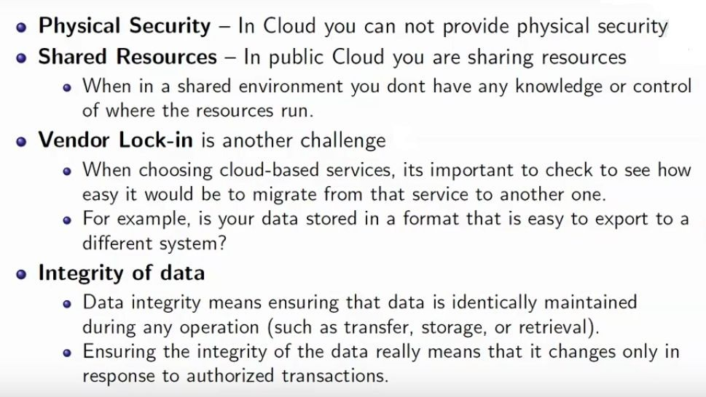

Slide 15
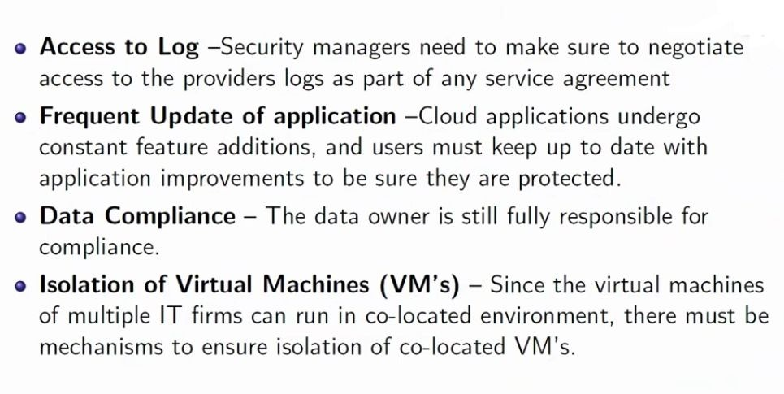

Slide 16
Security-as-a-Service(SECaas)

Slide 17
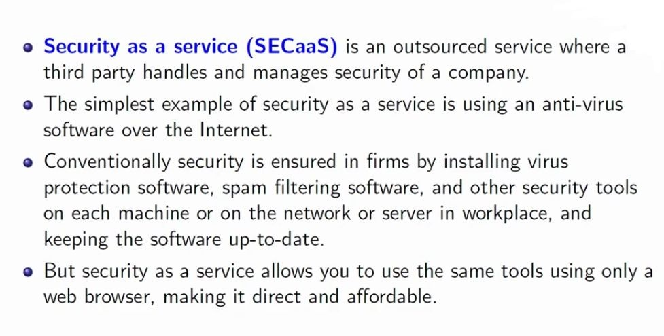

Slide 18
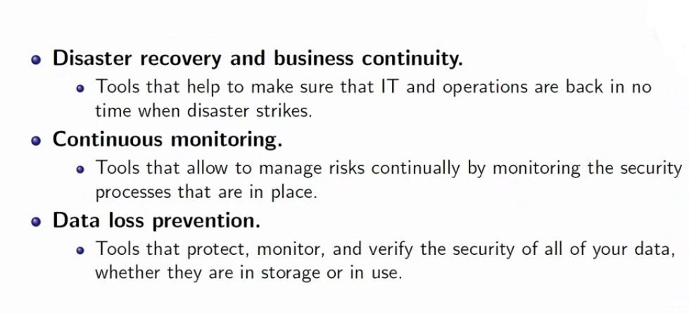
Security-as-a-Service Offerings

Slide 19
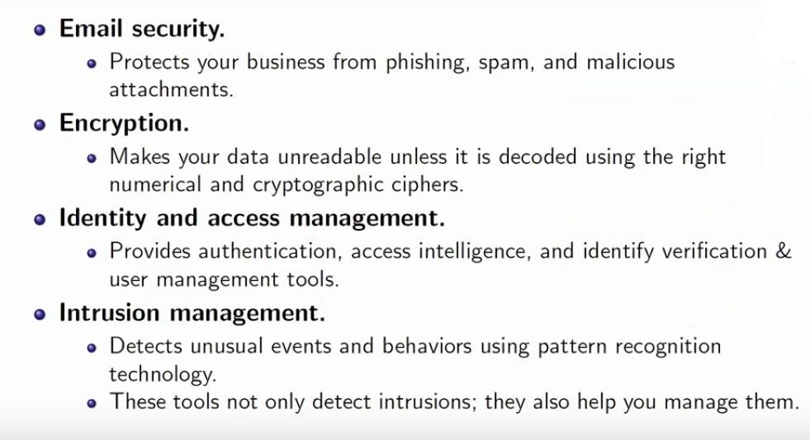

Slide 20
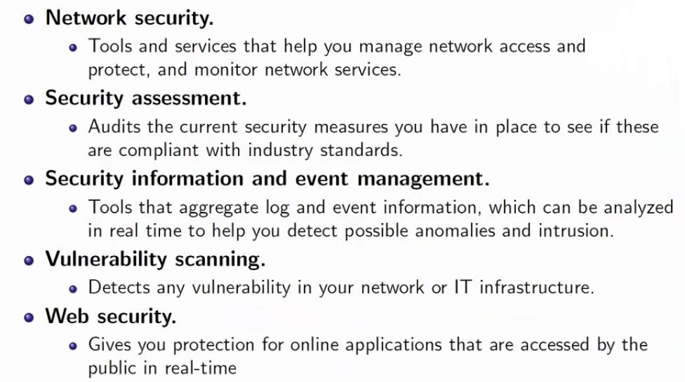

Slide 21
Security governance

Slide 22
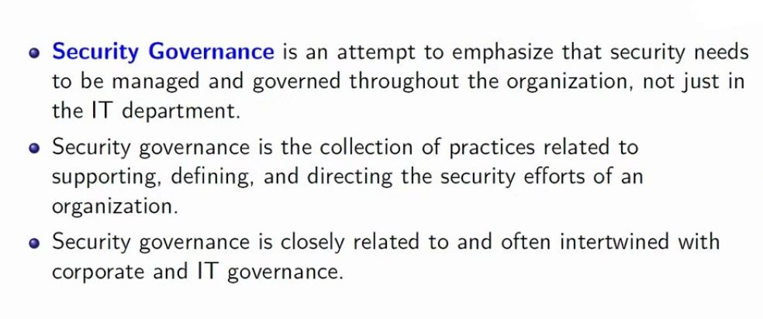

Slide 23
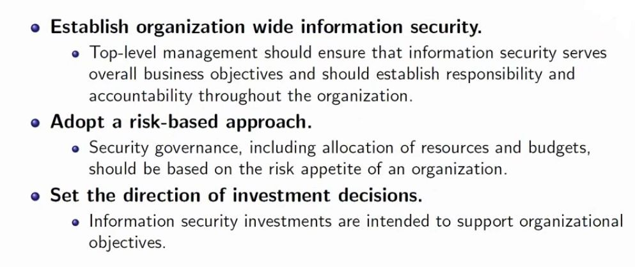
Security Governance -principles

Slide 24
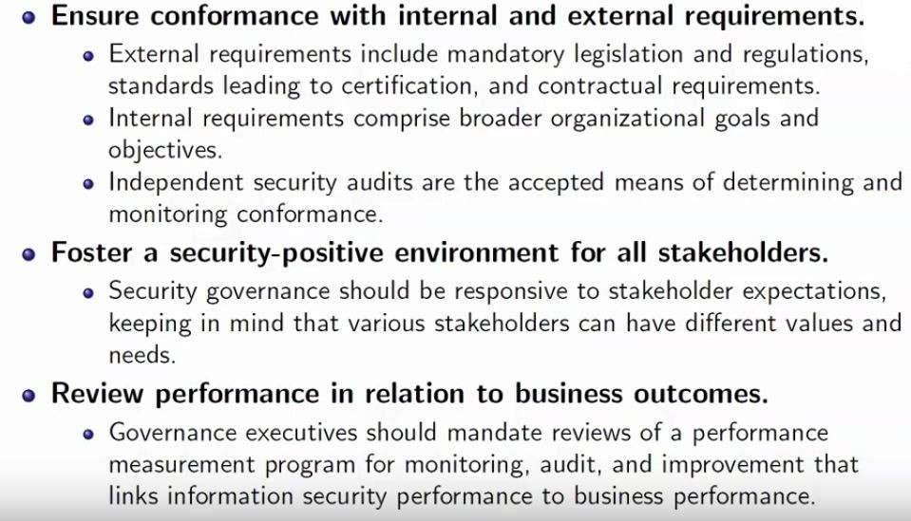

Slide 25
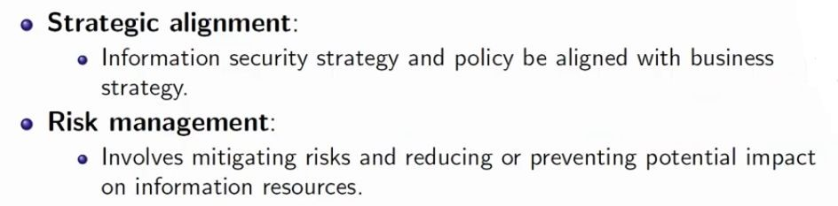
Security Governance-Desired Outcomes

Slide 26
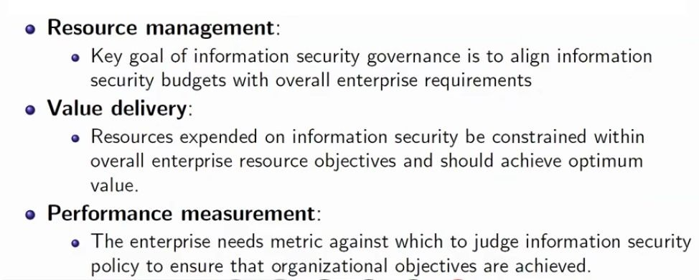
Security Governance-Desired Outcomes

Slide 27
Risk management in cloud

Slide 28
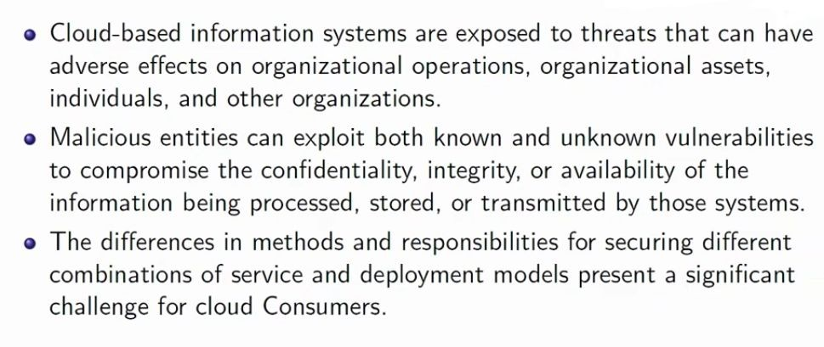
Risk management in cloud

Slide 29
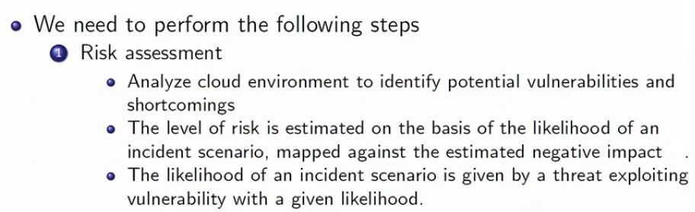
How it is done..

Slide 30
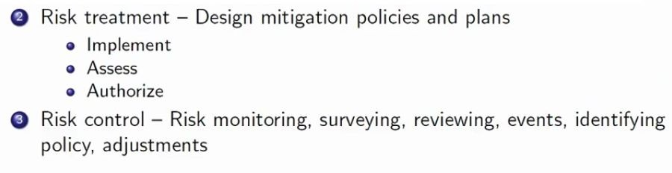
How it is done..

Slide 31
Security Portfolio Management
Security portfolio management is a fundamental component of ensuring eﬃcient and effective operation of any information security program and organization.
Lack of portfolio and project management discipline can lead to projects never being completed or never realizing their expected return.

Slide 32
For every new project that a security team undertakes, the team should ensure that a project plan and project manager with appropriate training and experience is in place so that the project can be seen through to completion.
Portfolio and project management capabilities can be enhanced by developing methodology, tools,and processes to support the expected complexity of projects that include both traditional business practices and cloud computing practices.

Slide 33
Secure Software Development Life Cycle (SecSDLC)

Slide 34
The SecSDLC involves identifying speciﬁc threats and the risks they represent, followed by design and implementation of speciﬁc controls to counter those threats and assist in managing the risks they pose to the organization and/or its customers.
The SecSDLC must provide consistency, repeatability, and conformance.
The SDLC consists of six phases, and there are steps unique to the SecSLDC in each of phases:

Slide 35
Phase 1.Investigation: Deﬁne project processes and goals, and document them in the program security policy.
Phase 2.Analysis: Analyze existing security policies and programs,analyze current threats and controls, examine legal issues, and perform risk analysis.
Phase 3.Logical design: Develop a security blueprint, plan incident response actions, plan business responses to disaster, and determine the feasibility of continuing and/or outsourcing the project

Slide 36
Phase 4.Physical design: Select technologies to support the security blueprint, develop a deﬁnition of a successful solution, design physical security measures to support technological solutions, and review and approve plans.
Phase 5.Implementation: Buy or develop security solutions. At the end of this phase, present a tested package to management for approval.
Phase 6.Maintenance: Constantly monitor, test, modify, update, and repair to respond to changing threats.

Slide 37
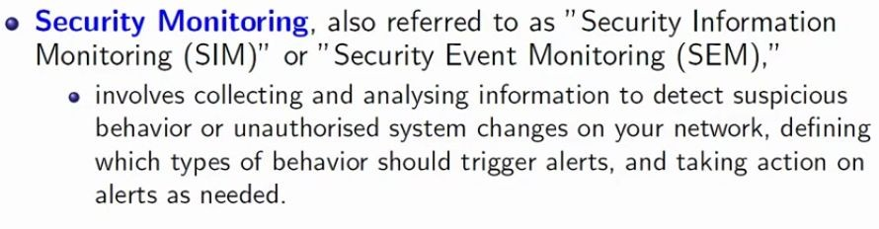
Cloud security monitoring-What it is..?

Slide 38
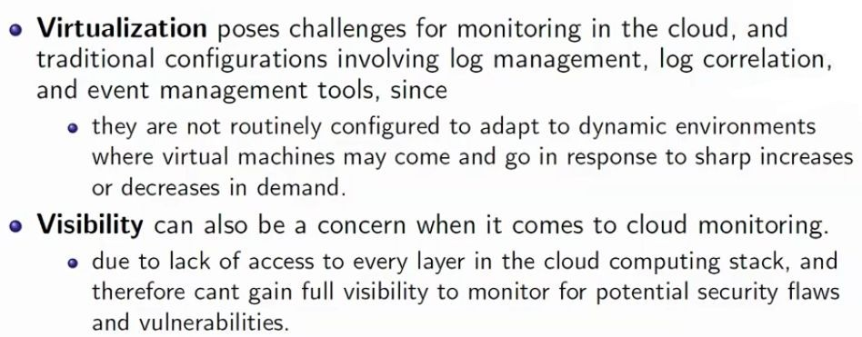
Challenges of cloud security monitoring

Slide 39
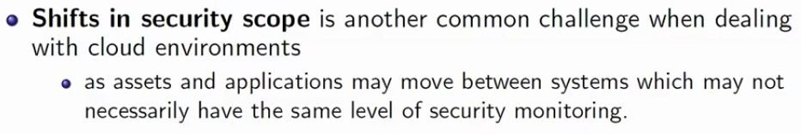
Challenges of cloud security monitoring

Slide 40
Security Architecture Design

Slide 41
A security architecture framework should be established with consideration of processes , operational procedures, technology speciﬁcations, people and organizational management, and security program compliance and reporting.
A security architecture document should be developed that deﬁnes security and privacy principles to meet business objectives.

Slide 42
Documentation is required for management controls and metrics speciﬁc to asset classiﬁcation and control, physical security, system access controls, network and computer management, application development and maintenance, business continuity, and compliance.
A design and implementation program should also be integrated with the formal system development life cycle to include a business case, requirements deﬁnition, design, and implementation plans.

Slide 43
Security services included in different layers are
Authentication
Authorization
Availability
Conﬁdentiality
Integrity
Accountability
Privacy

Slide 44
The creation of a secure architecture provides the engineers, data center operations personnel, and network operations personnel a common blueprint to design, build, and test the security of the applications and systems.
Design reviews of new changes can be better assessed against this architecture to assure that they conform to the principles described in the architecture
It allowing for more consistent and effective design reviews.

Slide 45
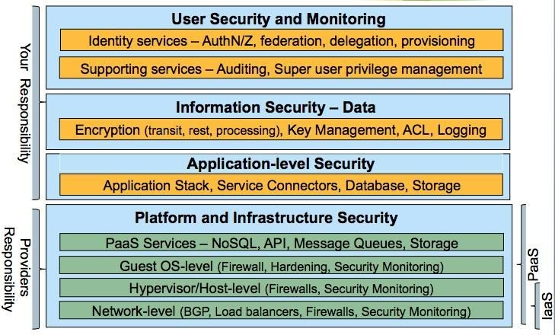
The ﬁgure below highlights the layers, within a cloud service, that are secured by the provider versus the customer.

Slide 46
Cloud security architecture-plan
As a ﬁrst step, architects need to understand what security capabilities are offered by cloud platforms (PaaS, IaaS).
The ﬁgure below illustrates the architecture for building security into cloud services.

Slide 47
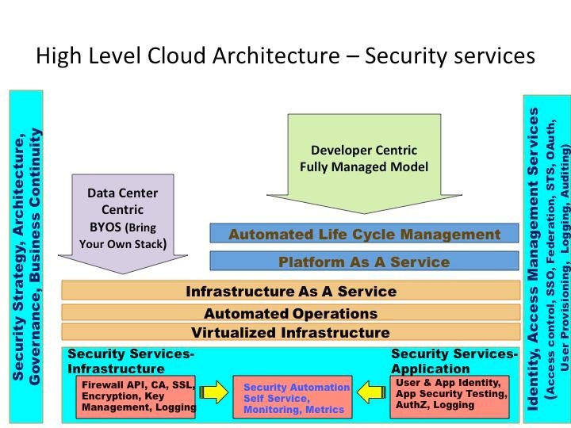

Slide 48
The following are cloud security best practices to mitigate risks to cloud services:
Architect for security-as-a-service: Ultimately this will mitigate threats due to human errors, improve operational eﬃciency and embed security controls into the cloud applications.
Implement sound identity, access management architecture and practice : Scalable cloud bursting and elastic architecture will rely less on network based access controls and warrant strong user access management architecture.

Slide 49
A sound architecture will enable reusability of identity and access services for all use cases in public, private and hybrid cloud models
Leverage APIs to automate safeguards
Always encrypt or mask sensitive data : Today’s private cloud applications are candidates for tomorrow’s public cloud deployment.
Hence architect applications to encrypt all sensitive data irrespective of the future operational model.

Slide 50
Do not rely on an IP address for authentication services : IP addresses in clouds are ephemeral in nature so you cannot solely rely on them for enforcing network access control.
Employ certificates (self-signed or from a trusted CA) to enable SSL between services deployed on cloud.
Log, Log, Log – Applications should centrally log all security events that will help create an end-to-end transaction view with non-repudiation characteristics.

Slide 51
Continuously monitor cloud services – Monitoring is an important function given that prevention controls may not meet all the enterprise standards. Security monitoring should leverage logs produced by cloud services, APIs and hosted cloud applications to perform security event correlation.

Slide 52
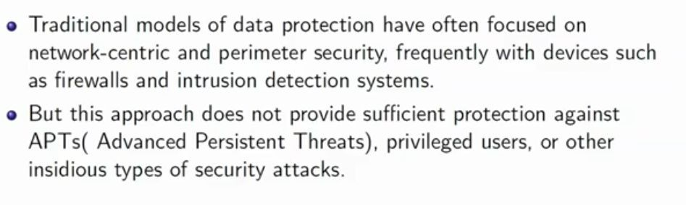
Data Security

Slide 53
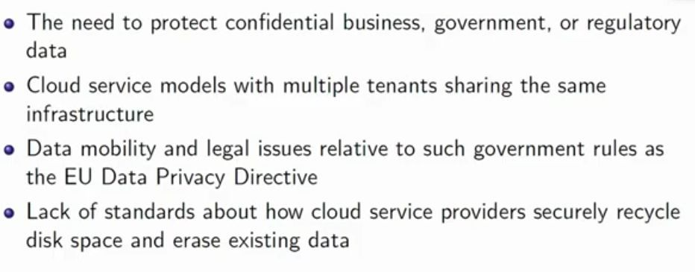
Data Security challenges in cloud.

Slide 54
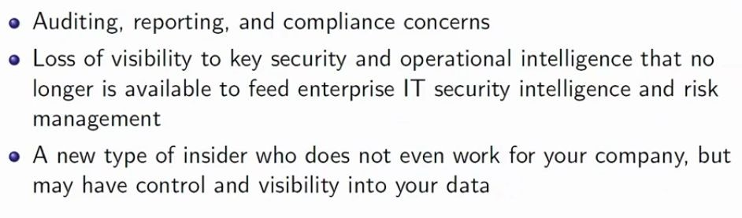

Slide 55
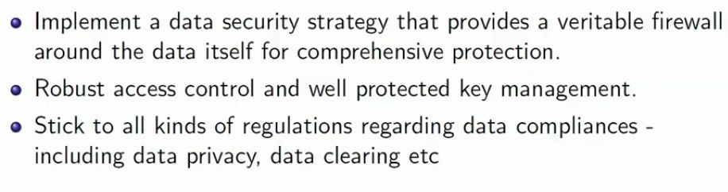
Techniques for protecting data in the cloud

Slide 56
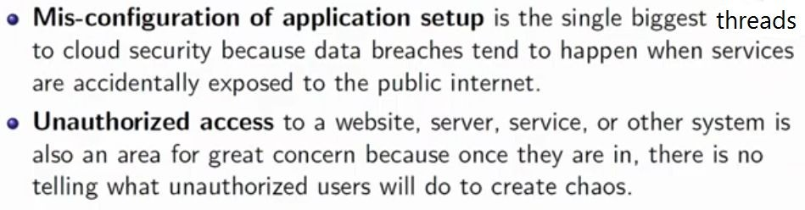
Common cloud application security threats

Slide 57
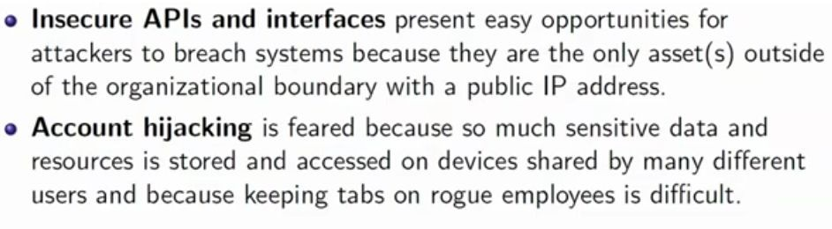
Common cloud application security threats

Slide 58
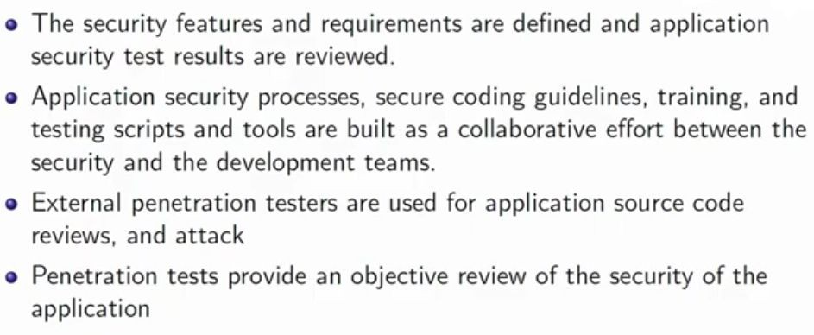
Cloud application security -How they do it..

Slide 59
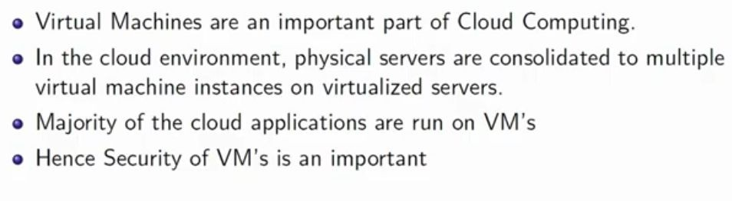
Virtual machine security

Slide 60
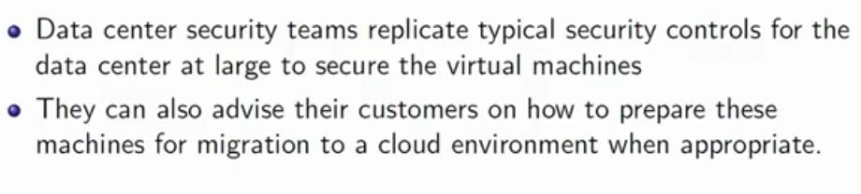
Virtual machine security-How it is done.?

Slide 61
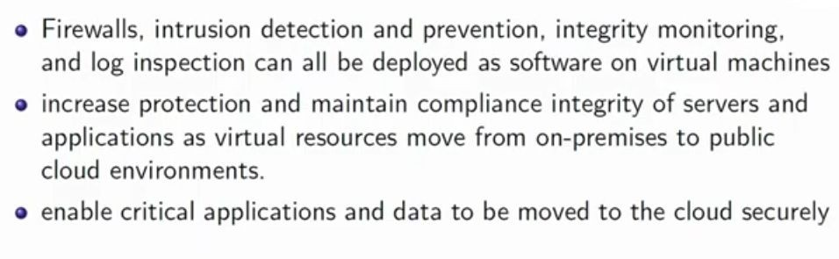
Virtual machine security-How it is done.?

Slide 62
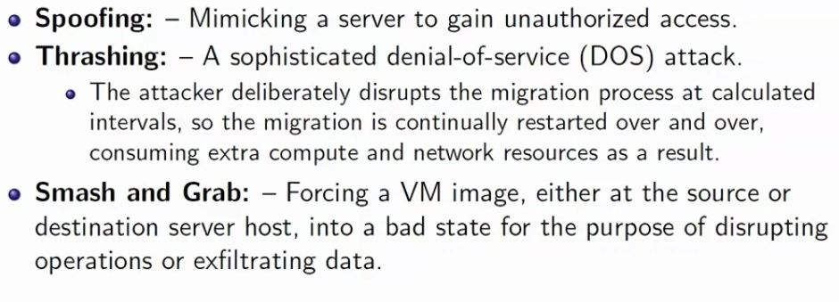
Cyber attacks that are speciﬁc to VM migration

Slide 63
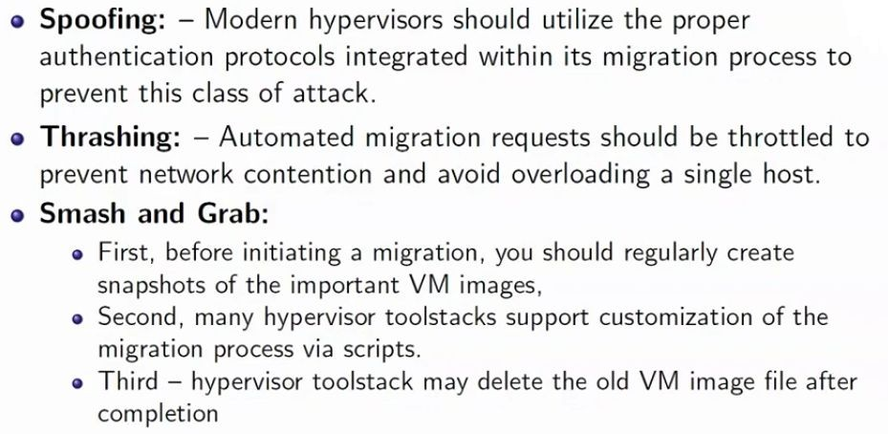

Slide 64
Identity Access Management (IAM)
Identity and access management is a critical function for every organization, and a fundamental expectation of SaaS customers is that the principle of least privilege is granted to their data.
The principle of least privilege states that only the minimum access necessary to perform an operation should be granted, and that access should be granted only for the minimum amount of time necessary.

Slide 65
The advent of cloud services and services on demand is changing the identity management landscape.
Most of the current identity management solutions are focused on the enterprise and typically are architected to work in a very controlled, static environment.

Slide 66
In the cloud environment, where services are offered on demand and they can continuously evolve, aspects of current models such as trust assumptions, privacy implications, and operational aspects of authentication and authorization, will be challenged.

Slide 67
Meeting these challenges will require a balancing act for SaaS providers as they evaluate new models an management processes for IAM to provide end-to-end trust and identity throughout the cloud and the enterprise.
Another issue will be ﬁnding the right balance between usability and security.
If a good balance is not achieved, both business and IT groups may be affected by barriers to completing their support and maintenance activities eﬃciently.

